Slide 1


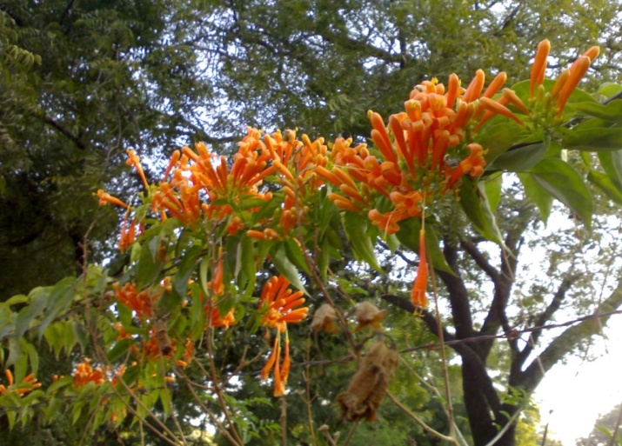
Electrodynamics-I

Slide 2
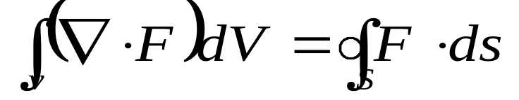
The Fundamental Theorem for Divergence
Statement: The integral of a derivative (here the divergence) over a region (here the volume) is equal to the value of the function at the boundaries (here the surface).
Use: To convert volume integral into surface intergral
3D
2D

Slide 3
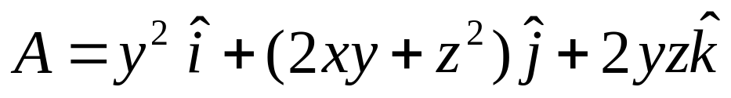
Question
Verify the Gauss divergence theorem for the function
and the unit cube situated at the origin
Z
S₅
S₄
1
S₁
S₂
o
1
Y
1
X
S₃
S₆

Slide 4
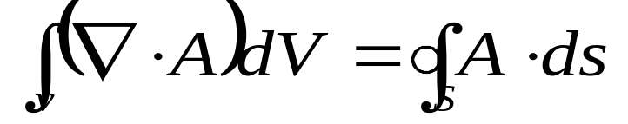
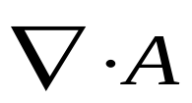
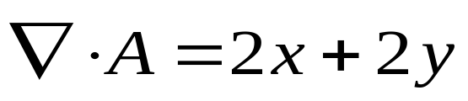
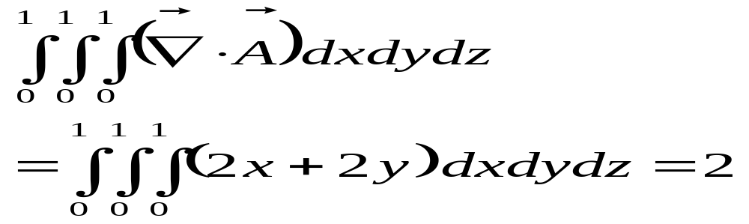
Solution
According to Gauss’s divergence theorem
L.H.S.
Step:1 First Calculate
Step:2

Slide 5
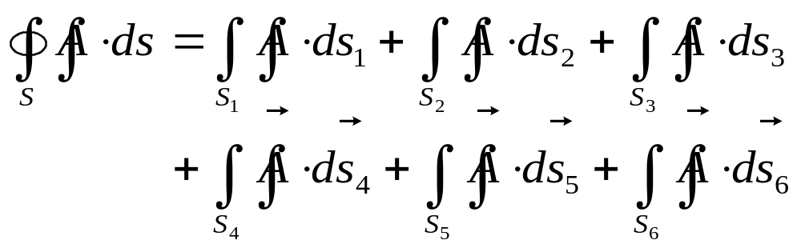
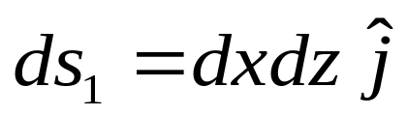
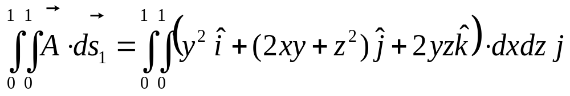
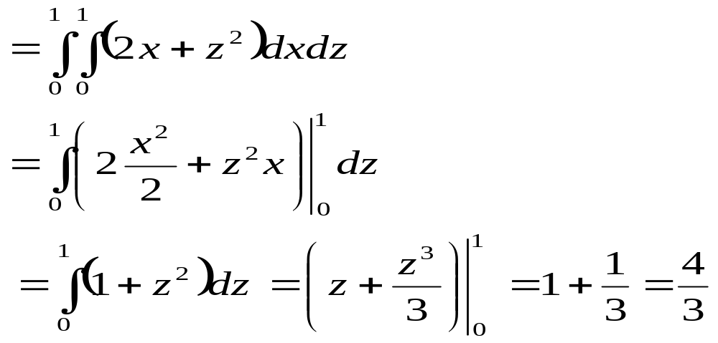
Cont…
R.H.S.
Surface 1 i.e. S₁ (at y =1)

Slide 6
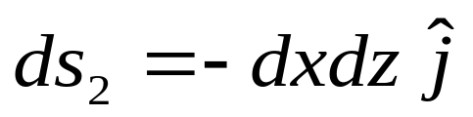
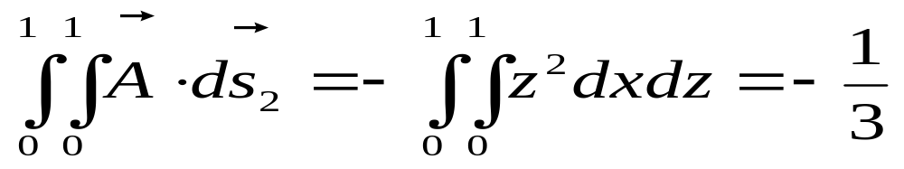
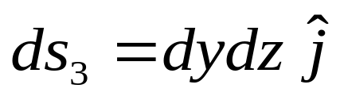
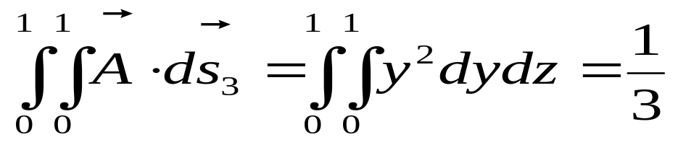
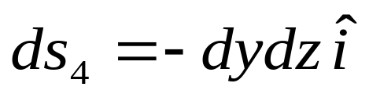
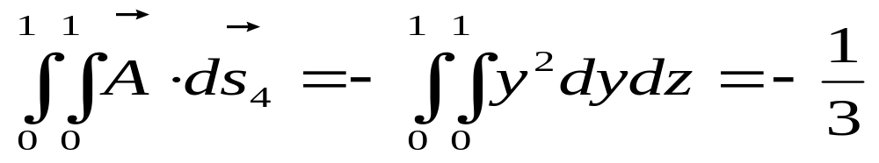
Cont…
Surface 2 i. e. S₂ (at y =0)
Surface 3 i.e. S₃ (at x = 1)
Surface 4 i.e. S₄ (at x = 0)

Slide 7
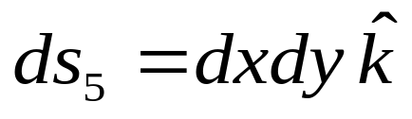
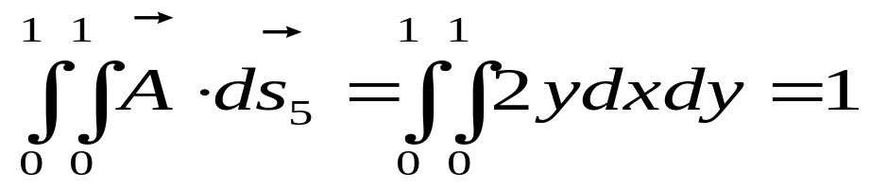
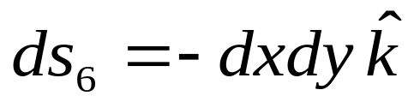
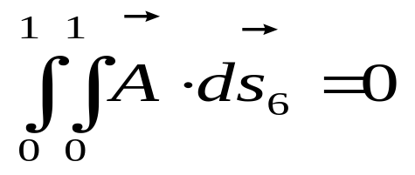
Cont…..
Surface 5 i.e. S₅ (at z = 1)
Surface 6 i.e. S₆ (at z = 0)
Total (R.H.S.) =4/3-1/3+1/3-1/3+1 = 2
Hence L.H.S.=R.H.S (Hence verified)

Slide 8
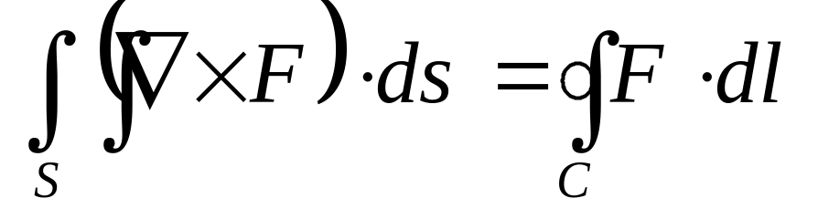
The Fundamental Theorem for Curl or
Stokes’ Theorem
Statement: The integral of a derivative (here curl) over a region (here, a patch of surface) is equal to the value of the function at the boundary (here perimeter of the patch)
2D
1D

Slide 9

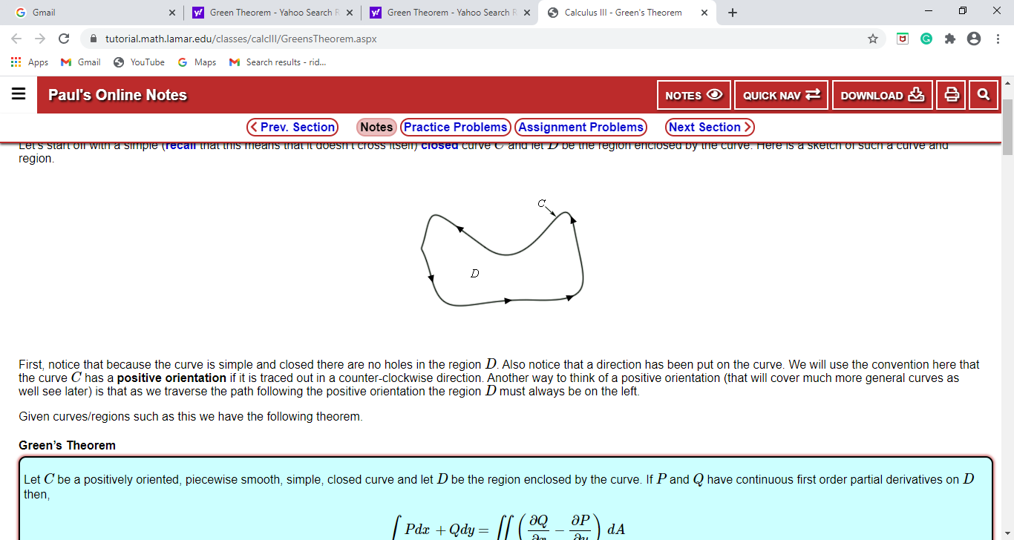
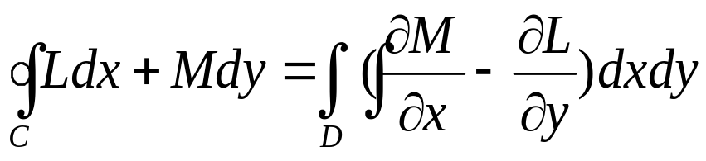
Green’s Theorem
Green's theorem gives the relationship between a line integral around a simple closed curve C and a double integral over the plane region D bounded by C.
If L and M are functions of (x, y) defined on an open region containing D and having continuous partial derivatives there, then
Mathematically
* Note: Here curve C has a positive orientation if it is traced out in a counter-clockwise direction

Slide 10
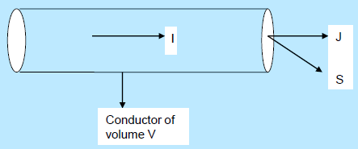

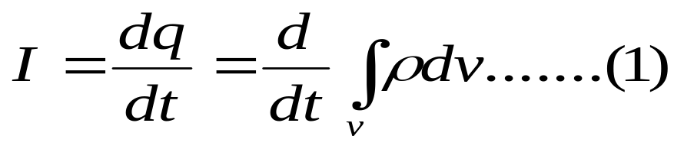
Equation of Continuity
Or
Conservation of Charge
Statement: The total current flowing out of some volume must be equal to the rate of decrease of the charge within that volume, if the charge is neither being created nor lost.
Since current is defined as the rate of flow of charge, the current
through the conducting cylinder is

Slide 11
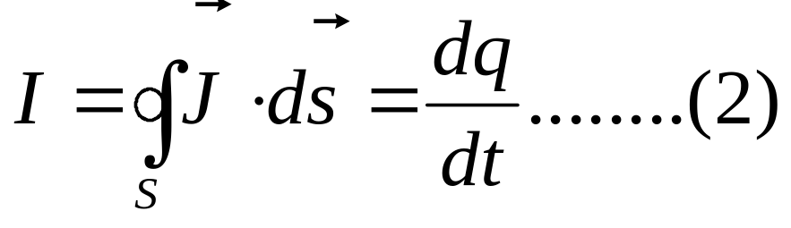
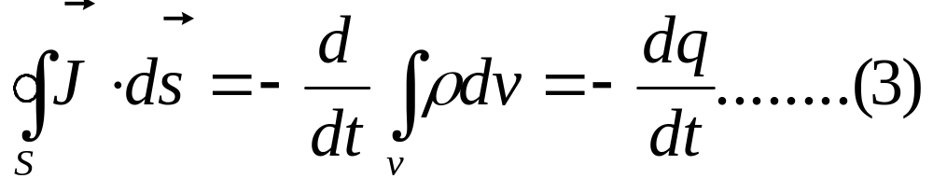
Cont…
Also, in terms of current density (defined as the amount of charge which crosses a unit area normal to the surface in unit time)
From Equations (1) & (2)
The minus sign indicates the decrease of charge in volume V

Slide 12
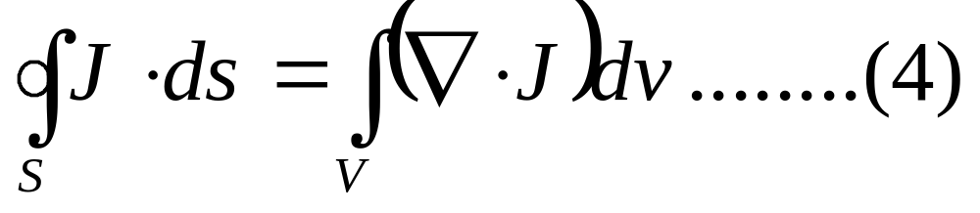
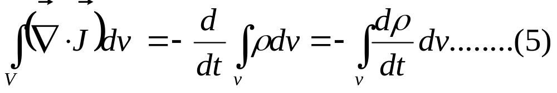
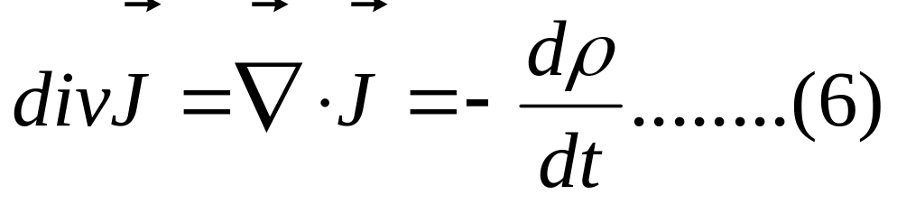
Cont…..
From Divergence Theorem [apply on L.H.S of Eq. (3)]
From equations (3) and (4)
Eq. (6) Is known as equation of continuity and represents the physical fact of conservation of charge.

Slide 13
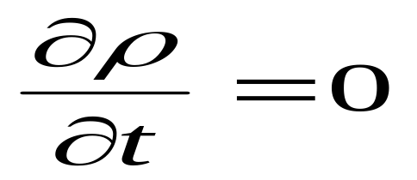
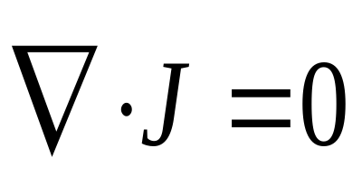
Cont……
For the steady state current (where charge density remain constant or if the value of current density remains unchanged with time) i.e.
So that

